Slide 1
Network Programming
CptS 360 Systems Programming
School of Electrical Engineering and Computer Science
Washington State University
Hassan Ghasemzadeh (hassan.ghasemzadeh@wsu.edu)

Slide 2
Topics
This part of the course covers basics of TCP/IP networks and network programming
Topics include
TCP/IP protocol
Socket programming

Slide 3
Introduction to TCP/IP

Slide 4
TCP/IP protocol
TCP/IP: backbone of Internet
TCP: Transmission Control Protocol
IP: Internet Protocol
Two versions of IP
IPv4: uses 32-bit address
IPv6: uses 64-bit address
Our focus: IPv4
TCP/IP stack:
TCP/IP is organized in several layers, referred to as TCP/IP stack

Slide 5
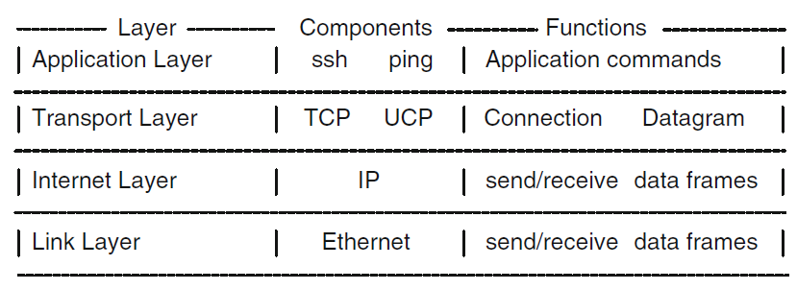
TCP/IP stack
Applications such as ssh (for login to remote hosts), mail, http (for Web pages) use TCP in the transport layer
Applications such as ping (to query other hosts) use UDP in transport layer for efﬁciency
Transport layer: responsible for send/receive application data as packets to/from IP hosts
Data transfer at or above the transport layer between processes and hosts are only logical
Actual data transfer occurs in Internet and Link layers, which divide data packets into data frames for transmission across physical networks

Slide 6
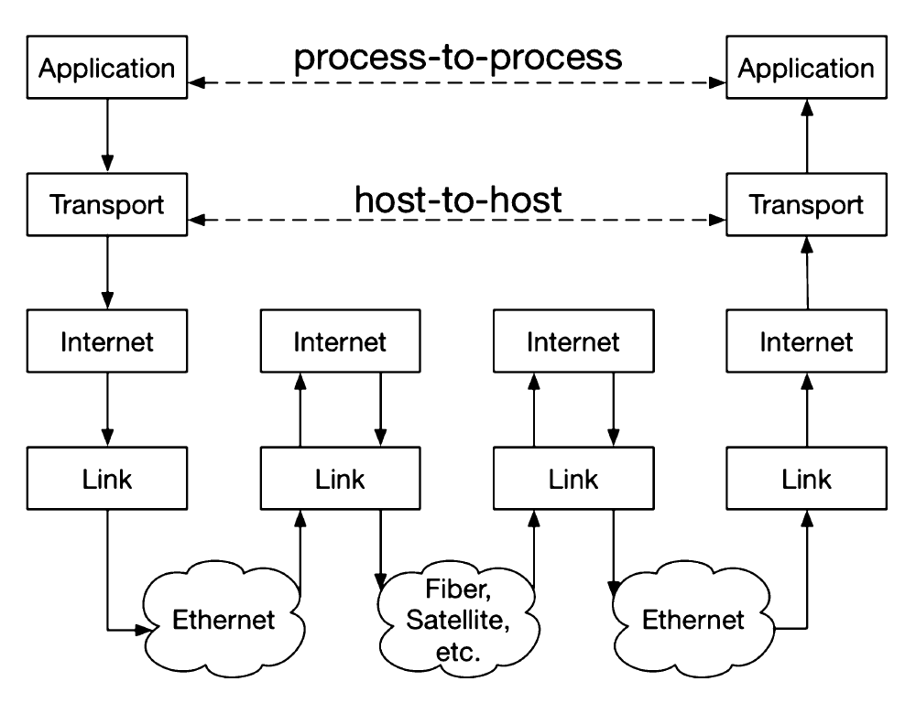
Data flow in TCP/IP networks

Slide 7
Data flow in TCP/IP networks (cont.)
Application in one location tries to communicate with an application at another location. This is a virtual connection between the two processes.
Application layer relies on transport layer to exchange information between the two hosts
Transport layer breaks down the data into packets
The data goes to internet layer and then physical layer
Between the hosts are routers which use sender address and receiver address to route data frames over the Internet
Every host or device is identified by a unique IP address. The device runs the TCP/IP protocol to accommodate this data exchange paradigm

Slide 8
IP host and IP address
Host: a computer or device that supports TCP/IP protocol
IP address: each host is identiﬁed by a 32-bit number called the IP address
The 32-bit IP address is expressed in a dot notation, e.g.,134.121.64.1
Host name: a host is also known by a host name, e.g., dns1.eecs.wsu.edu
Applications usually use host names rather than IP addresses
Host name and IP address are equivalent
Given one, we can ﬁnd the other using DNS (Domain Name System)

Slide 9
IP Address
IP address is divided into two parts, NetworkID and HostID
IP addresses are classiﬁed into classes A to E
For example, a class B IP address is divided into a 16-bit NetworkID, in which leading 2 bits are 10, followed by a 16-bit HostID ﬁeld.
Why dividing the address into two parts?
Data packets intended for an IP address are ﬁrst sent to a router with same NetworkID
Router forwards packets to a host in that network (HostID)
Every host has a local host name localhost with a default IP address 127.0.0.1
Link layer of localhost is a loop-back virtual device (routes data packet back to the same localhost)
Allows us to run TCP/IP applications on same computer without connecting to Internet

Slide 10
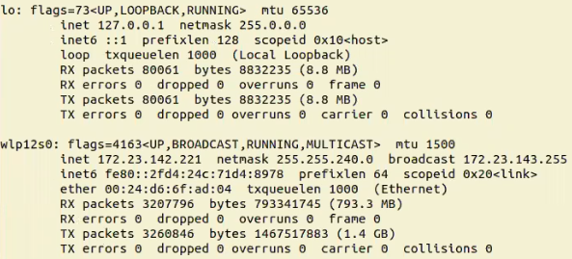
ifconfig
ifconfig command gives you the TCP/IP configuration for a host
localhost
Temporary/dynamic IP address (assigned e.g., by WSU wireless)
No host name is assigned to the host computer in this example, because this computer does not have a permanent IP address on the Internet

Slide 11
IP protocol
What is IP protocol:
A protocol for sending/receiving data packets between hosts
IP operates in a best-effort manner
An IP host sends packets to a receiving host, but it does not guarantee packets will be delivered or the ordering will be correct
This means that IP is not a reliable protocol

Slide 12
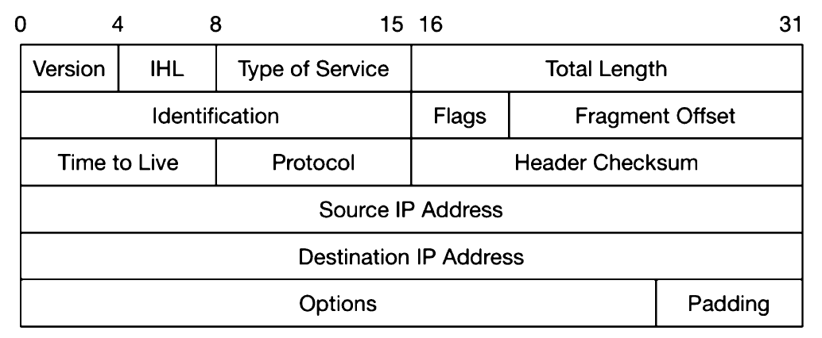
IP packet format
Maximum size of each IP packet is 64 KB
IP packet consists of
IP header
Contains information such as total length, whether packet uses TCP or UDP, time-to-live (TTL) count, check-sum for error detection
Sender and receiver IP addresses
Data

Slide 13
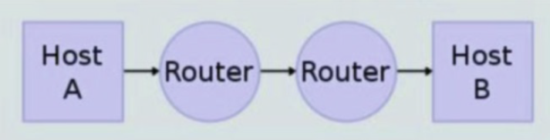
Router
What are routers for?
Usually not possible to send data packets from one host to the other directly
Routers are hosts that receive and forward packets
TTL
Each IP packet has an 8-bit Time-To-Live (TTL) count in the IP header, which has a maximum value of 255.
What is TTL for?
At each router, TTL is reduced by 1
If the TTL reaches 0 the packet is simply dropped by router
Prevents packets from circulating around indeﬁnitely

Slide 14
TCP (Transmission Control Protocol)
TCP is built on top of IP protocol to provide reliable data transfers
TCP is a connection-oriented protocol for sending/receiving streams of data
Port number
Each application is uniquely identiﬁed by a triple “Application=(HostIP, Protocol, PortNumber)”
Protocol: TCP or UDP
PortNumber: a unique unsigned short integer assigned to the application.

Slide 15
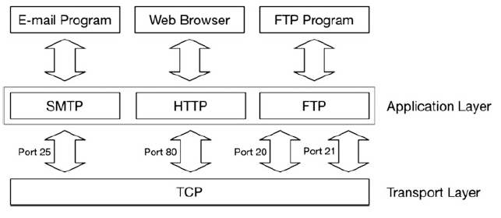
Applications using TCP
To use UDP or TCP, an application (process) must choose or obtain a PortNumber ﬁrst
First 1024 port numbers are reserved
Other port numbers are available for general use
An application may either choose an available port number or let OS kernel assign a port number

Slide 16
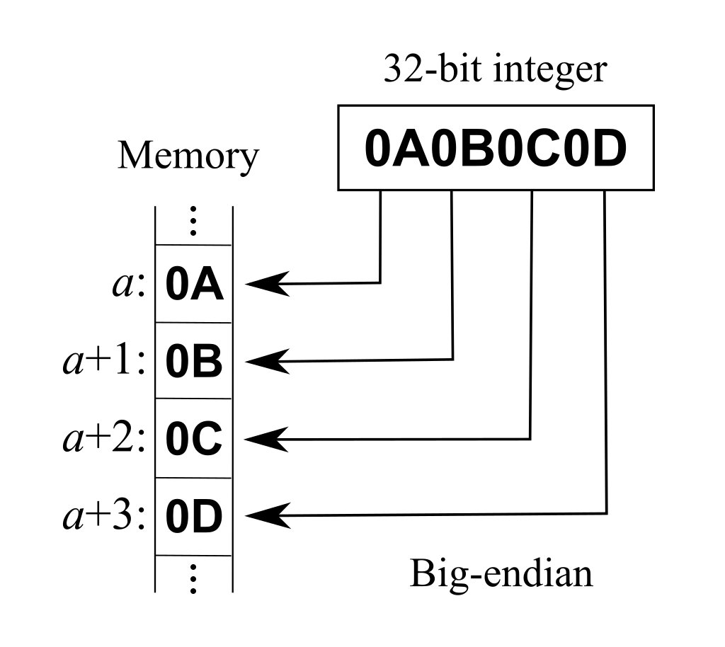
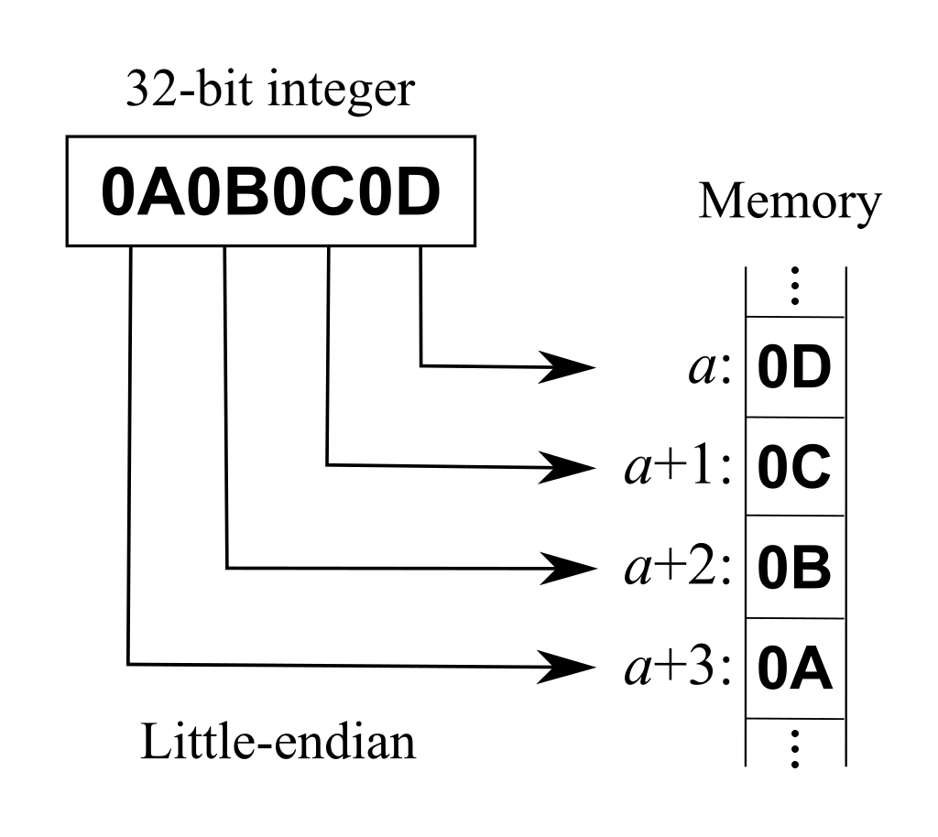
Big-endian versus little-endian
Recall from computer architecture course that computers may use either big-endian or little-endian byte order
Endianness refers to order or sequence of bytes in computer memory.
Images: Wikipedia

Slide 17
Network and host byte orders
On Internet, data are always in network order, which is big-endian
What to do on little-endian machines?
For little-endian machines (e.g., Intel x86 based PCs) library functions such as htons(), htonl(), ntohs(), ntohl(), are available to covert data between host order and network order
A port number 1234 in a PC is an unsigned short integer in host (little-endian) byte order. It must be converted to network order by using htons(1234) before usin
Conversely, a port number received from the Internet must be converted to host order by ntohs(port)
htons(): converts the unsigned short integer hostshort from host byte order to network byte order
htonl(): converts the unsigned integer hostlong from host byte order to network byte order
ntohs: converts the unsigned short integer netshort from network byte order to host byte order
ntohl(): converts the unsigned integer netlong from network byte order to host byte order

Slide 18
Socket Programming

Slide 19
Network programming
All Unix/Linux systems provide TCP/IP support for network programming
Most network programming tasks are based on the server-client computing model
Server-client computing model
We run a server process at a server host
We then run a client from a client host
In TCP
server waits for a client to connect
client ﬁrst connects to server to establish a virtual circuit
server and client can now exchange continuous streams of data

Slide 20
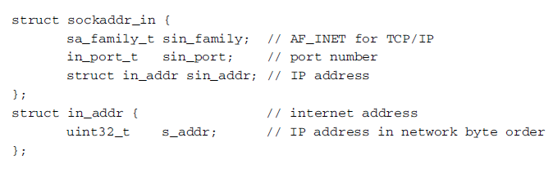
Socket programming
What is socket programming?
In network programming, user interface to TCP/IP is through a set of C library functions and system calls, known as sockets API
To use socket API, we need socket address structure (used to identify server and client)
The socket address structure is deﬁned in netdb.h and sys/socket.h

Slide 21
Socket address
In the socket address structure,
sin_family is always set to AF_INET for TCP/IP networks
sin_port contains the port number in network byte order
sin_addr is the host IP address in network byte order

Slide 22
Socket API
Server
A server must create a socket and bind it with a sockaddr containing the server’s IP address and port number
How to choose a port number?
Either use a ﬁxed port number, or let OS kernel choose a port number (if sin_port is 0)
Client
To communicate with server, client must create a socket as well.

Slide 23
Creating a socket
To create a socket, use socket() system call with the following format
int socket(int domain, int type, int protocol)
Example
Create a connected-oriented TCP socket for sending/receiving data streams:
int tcp_sock=socket(AF_INET, SOCK_STREAM, 0);
A new socket does not have an address
Must be bound with a host address and port number to identify either receiving host or sending host. This is done by the bind() system call.

Slide 24
Binding a socket
Use bind() system call with the following format
int bind(int sockfd, struct sockaddr *addr, socklen_t addrlen);
What does bind() do?
Assigns address speciﬁed by addr to socket referred to by the ﬁle descriptor sockfd
addrlen speciﬁes size in bytes of address structure pointed to by addr.

Slide 25
TCP Sockets
listen() and accept()
After creating a socket and binding it to server address, a TCP server uses listen() and accept() to accept connections from clients
int listen(int sockfd, int backlog);
listen() marks the socket referred to by sockfd as a socket that will be used to accept incoming connection
backlog deﬁnes maximum queue length of pending connections

Slide 26
TCP Sockets (cont.)
int accept(int sockfd, struct sockaddr *addr, socklen_t *addrlen);
accept() extracts the ﬁrst connection request on the queue of pending connections for the listening socket, sockfd, creates a new connected socket, and returns a new ﬁle descriptor referring to that socket
When executing accept(), TCP server blocks until a client has made a connection through connect()

Slide 27
TCP Sockets (cont.)
int connect(int sockfd, const struct sockaddr *addr, socklen_t addrlen);
connect() connects socket referred to by ﬁle descriptor sockfd to address speciﬁed by addr
addrlen speciﬁes size of addr
If socket is of type SOCK_STREAM (TCP socket), connect() attempts to make a connection to socket that is bound to the address speciﬁed by addr

Slide 28

send()/read() and recv()/write()
After establishing a connection, both TCP hosts may use send() /write() to send data, and recv()/read() to receive data
Their only difference is the ﬂag parameter in send() and recv(), which can be set to 0 for simple cases.

Slide 29
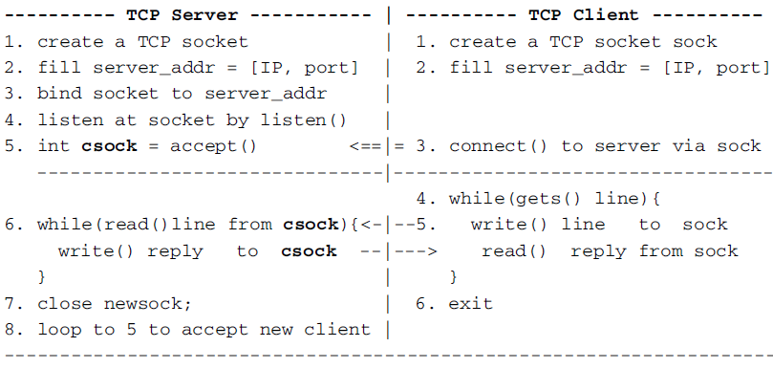
Example: TCP echo server-client program
A simple echo server-client program using TCP
Assumptions:
Both the server and client run on the same computer
Server port number is hard coded as 1234.
The following shows algorithms and sequence of actions.

Slide 30
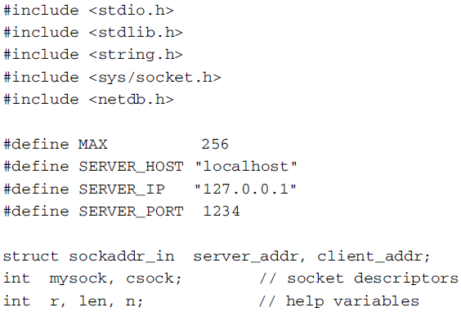
Server code
These are header and variable section in server.c file

Slide 31
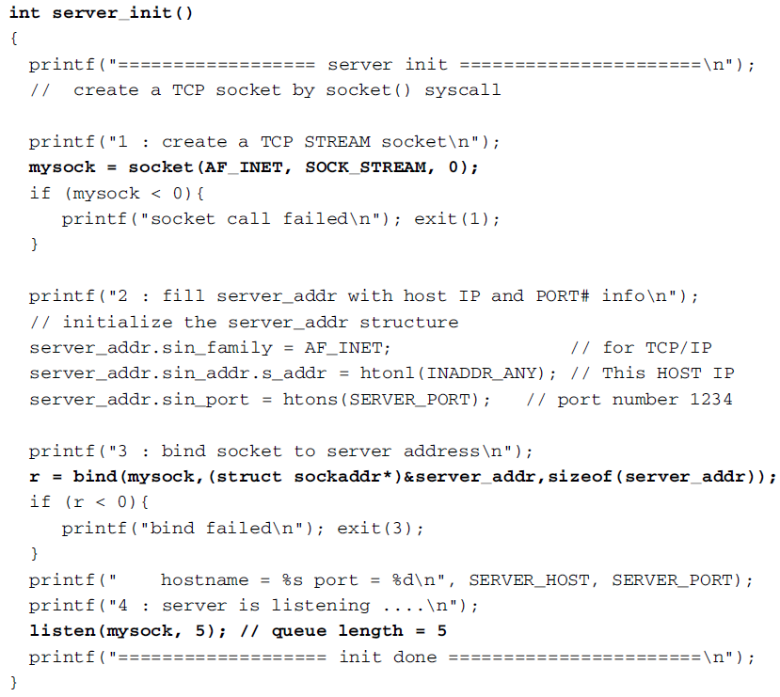
Server code (cont.)

Slide 32
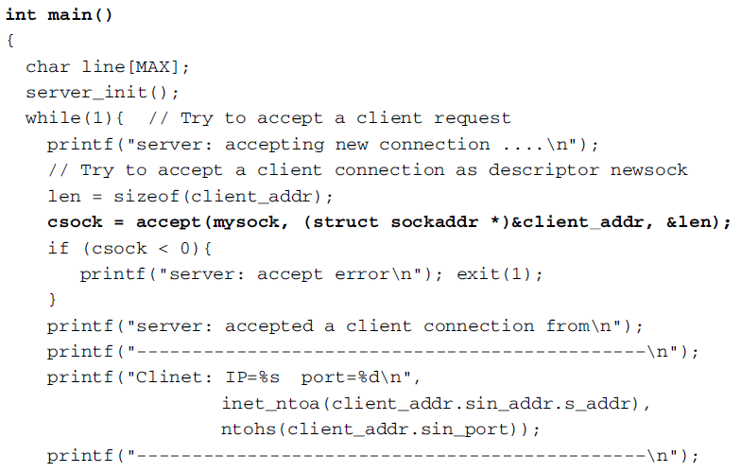
Server code (cont.)

Slide 33
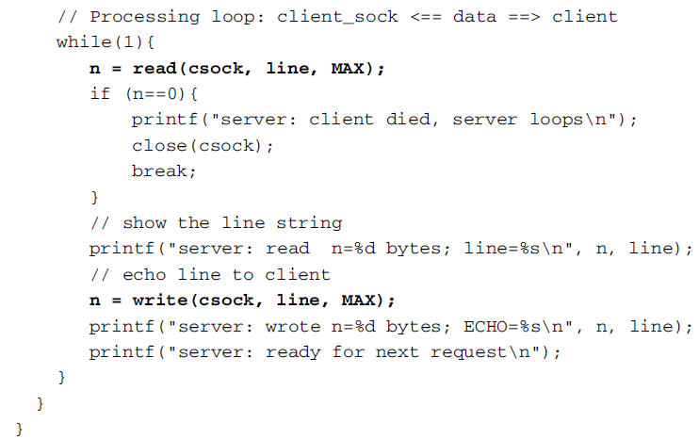
Server code (cont.)

Slide 34
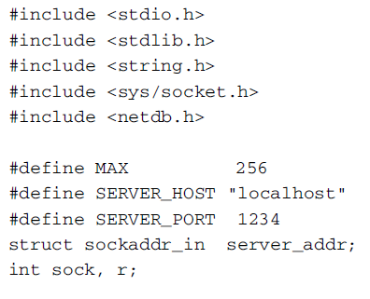
Client code
These are header and variable section in client.c file

Slide 35
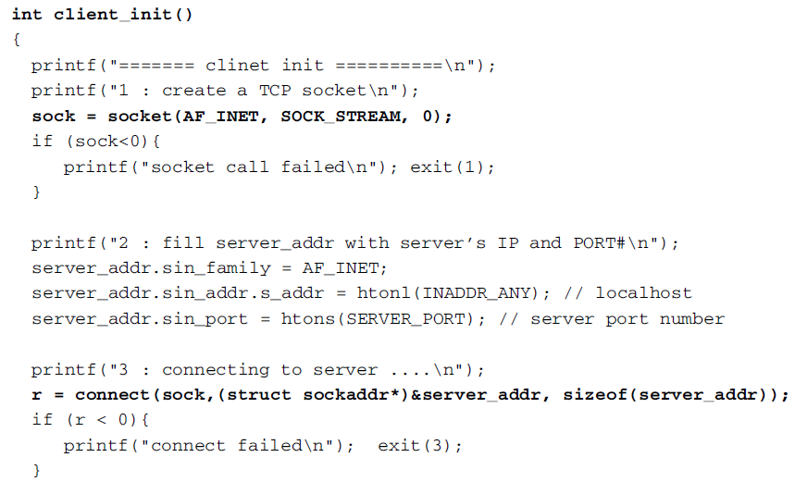
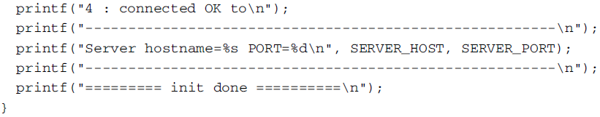
Client code (cont.)

Slide 36
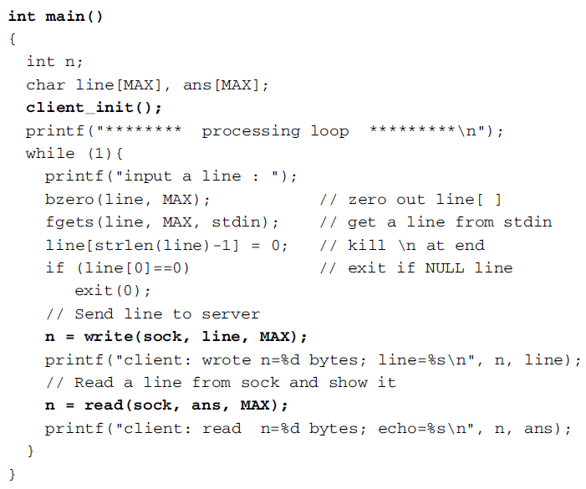
Client code (cont.)

